Slide 1
CAM CONSTRUCTION
21st Century School Buildings Plan
Robert Poole Building #056 (Additions and Renovation):
ACCE Academy and Independence Local 1
Construction Update Meeting: October 13, 2016

Slide 2
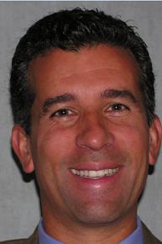
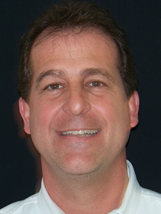
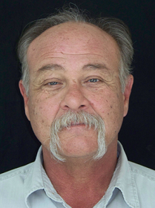
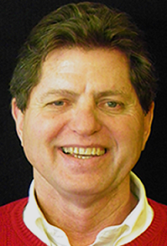
CAM Team Introduction
Marc Munafo
President
John Speights
Vice President
Jeff Schissler
Superintendent
Rick Gabell
On-Site Project Manager
Construction Update| Robert Poole Building| October 13, 2016 | www.baltimore21stcenturyschools.org

Slide 3
Street Lighting Repairs
We apologize for the inconvenience.
Street Lighting Repair Chronology
8/25: Notify Miss Utility
8/29: Miss Utility Completes Location Survey
8/16 – 9/7: Fence Contractor Installs Construction Fence
9/9: CAM Calls BGE for Emergency Service to Repair Damage
9/14: Baltimore City and BGE Investigation Begins
9/15: CAM Schedules Light Tower for 9/15 but was Cancelled by Committee
9/27: Temporary Light Tower Installed Activated
9/28: BGE, BC Street Lighting Investigation & Repair Plan Developed
10/7: Temporary Light Pole Installation
TBD by Community: BGE Adjust Temporary Flood Lights
2017: BGE Design New Duct Bank and Reconnect Existing Lights

Slide 4
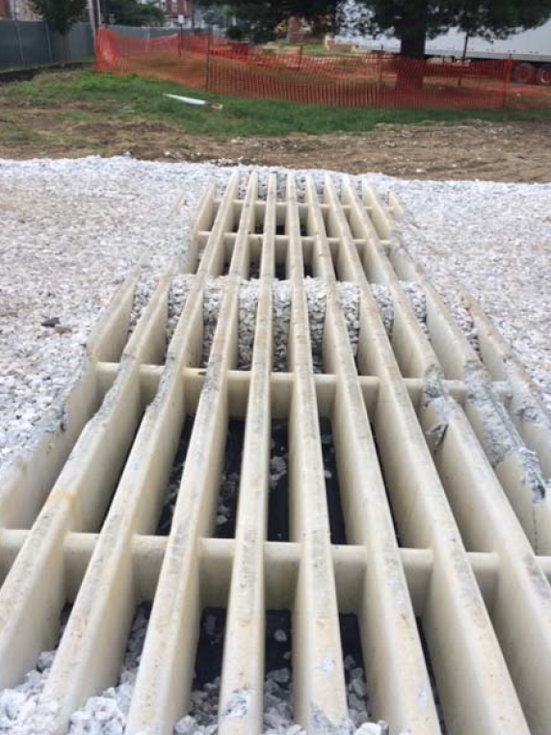
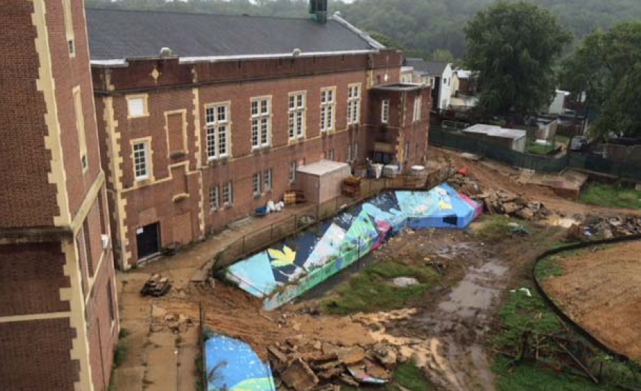
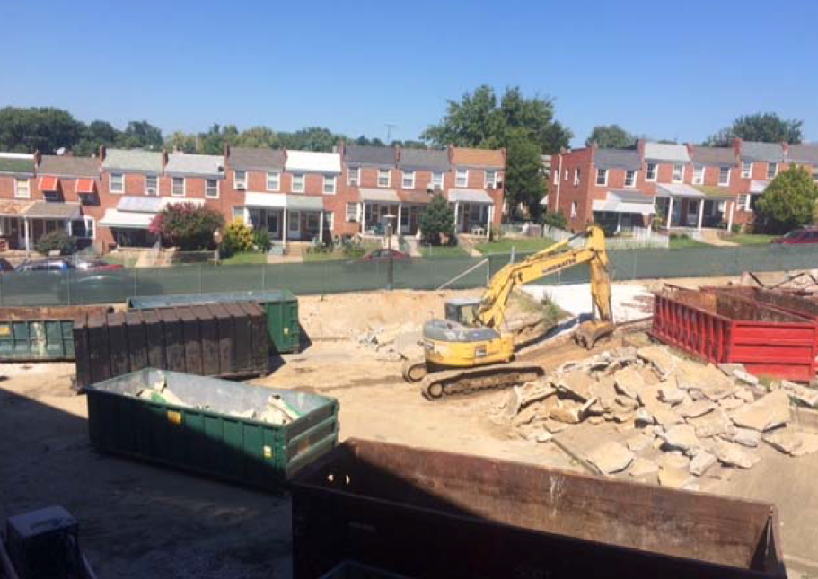
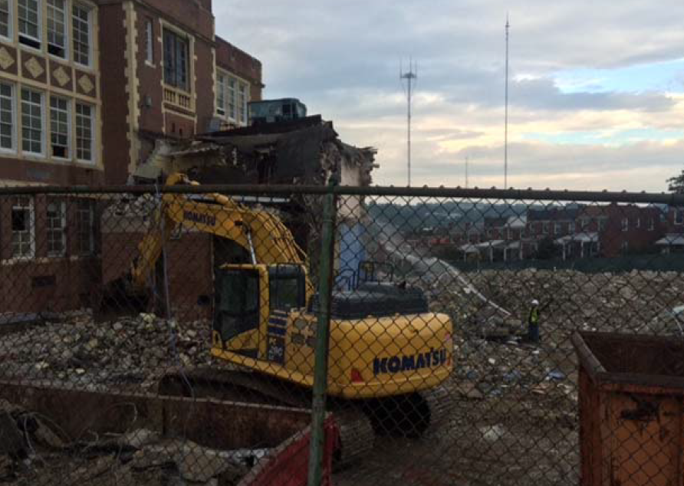
Razing, Recycling, S&E Control
What we have been doing…
Construction Update| Robert Poole Building| October 13, 2016 | www.baltimore21stcenturyschools.org

Slide 5
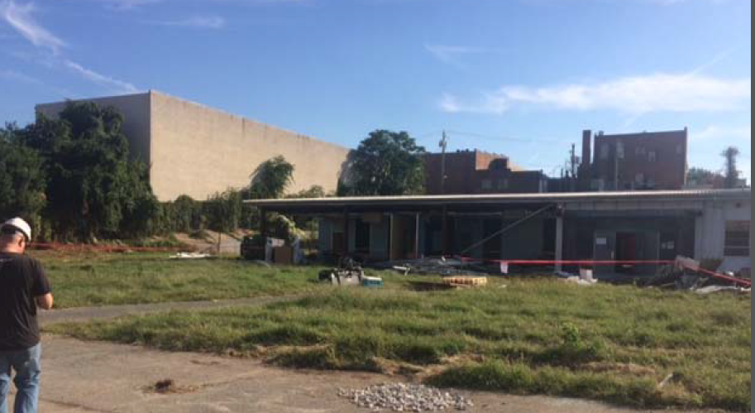
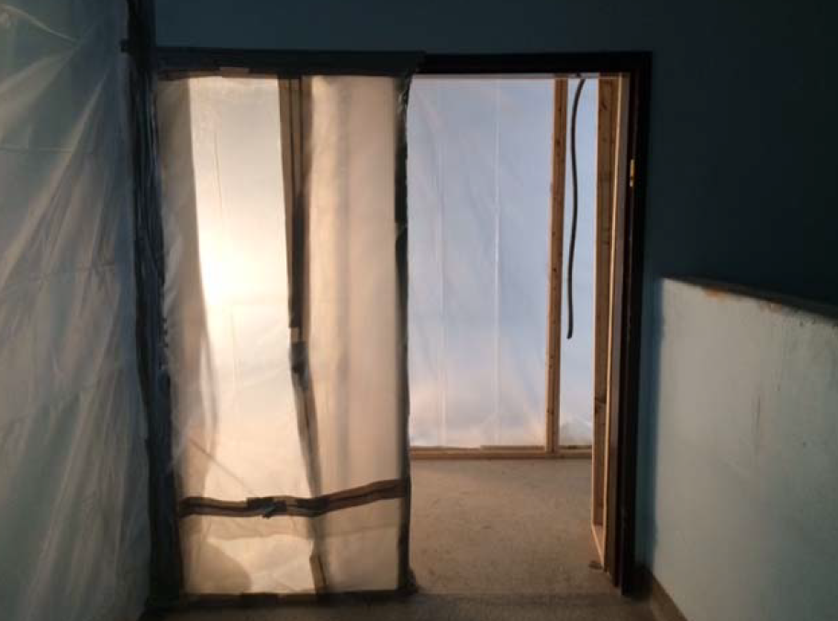
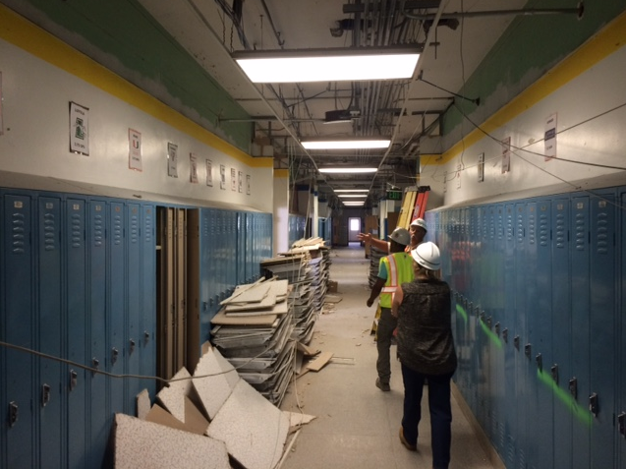
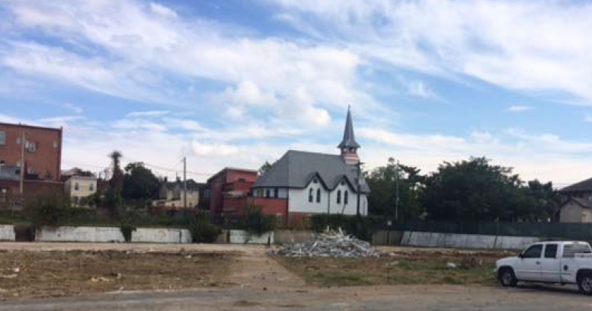
Annex Razing, Interior Demolition & Containment
Construction Update| Robert Poole Building| October 13, 2016 | www.baltimore21stcenturyschools.org

Slide 6
Look Ahead Schedule
What lies ahead…
1st Floor Demolition Main Building “B” ………………………………. Oct 13 – Oct 28
Gymnasium Demolition Building “A” ………………………………….. Oct 13 – Oct 20
3rd Floor Asbestos Abatement Main Building ……………………… Oct 13 – Oct 28
Gymnasium Asbestos Abatement Building “A” …………………… Oct 20 – Oct 28
Brick Salvage West Wing ……………………………………………………. Oct 13 – Oct 20
Remove West Wing Roof ……………………………………………………. Oct 10 – Oct 17
Raze West Classroom Building …………………………………………… Oct 17 – Oct 28
Crush Brick, Block and Concrete ………………………………………… Oct 31 – Nov 23
Construction Update| Robert Poole Building| October 13, 2016 | www.baltimore21stcenturyschools.org

Slide 7
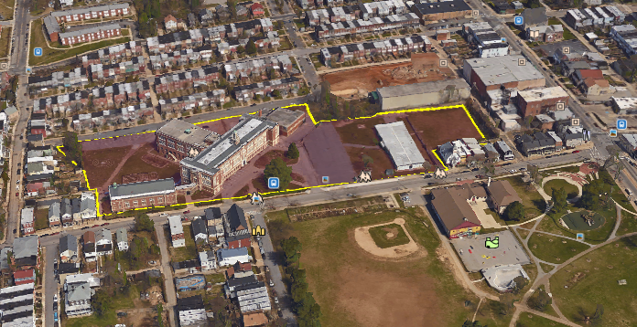
Existing Site
Berry Street
Falls Road
Buena Vista Ave
W. 36th Street
Construction Update| Robert Poole Building| October 13, 2016 | www.baltimore21stcenturyschools.org

Slide 8
Thank You!
www.baltimore21stcenturyschools.org
Questions?
21st Century School Buildings Program Baltimore City Public Schools 200 East North Avenue Room 407-B
Baltimore MD 21202
(443) 642-4600
Mignon R. Anthony Executive Director, 21st Century Buildings Program Baltimore City Public Schools
Gary McGuigan Senior Vice President, Capital Development Division Maryland Stadium Authority
Dawn Kirstaetter Deputy Mayor, Health, Human Services, Education and Youth City of Baltimore
David Lever Executive Director, Public School Construction Program State of Maryland
This presentation has been brought to you by the 21st Century School Buildings Program and CAM Construction.

