Slide 1
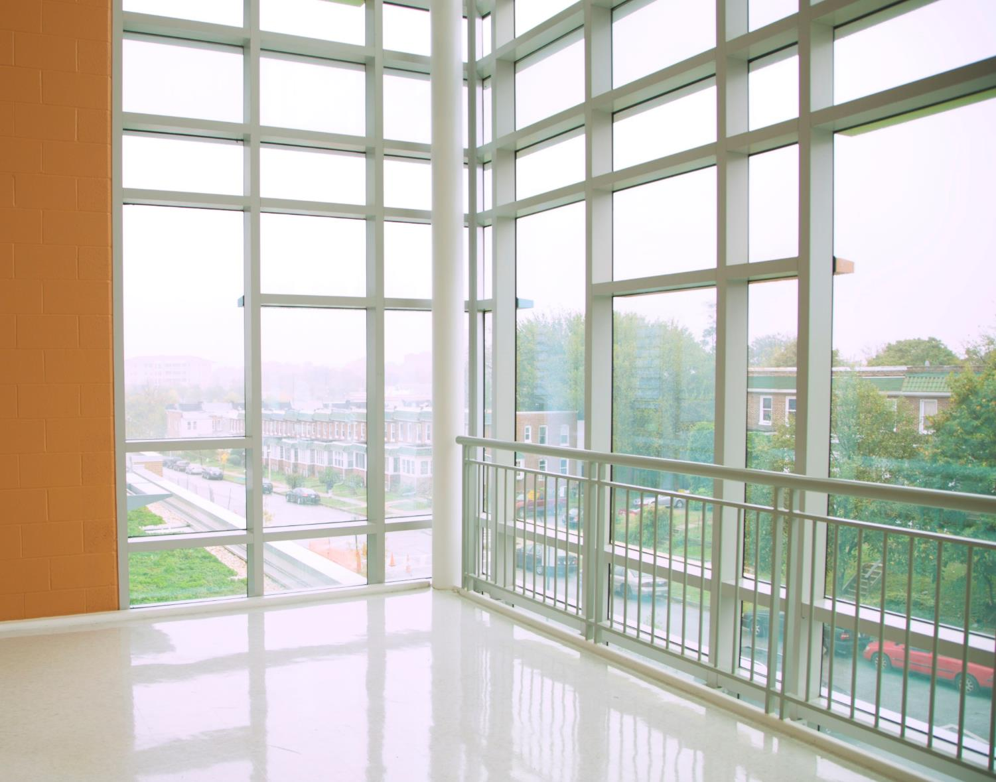


21st Century School Buildings Plan
SCHOOL Patterson High School & Claremont Middle/High Elementary School
COMMUNITY MEETING Construction Update| October 8, 2019

Slide 2
Introductions and Agenda
Introductions
Agenda
Alicia Thomas
21st Century School Buildings Program
Program Coordinator
Baltimore City Schools
Tiara Moorman
Project Manager
Maryland Stadium Authority
Jerry Marinzel
Project Architect
Stantec
Aaron Mengel
Senior Project Manager
Skanska Construction Company
Design
Exterior Views and Landscape
Schedule
Site Phasing Plan
“What’s happening now”
Next Steps
Feedback
Notes:
Abut USA Architects: About us……
30 Year Old Regional Architectural Firm
Extensive K-12 School Design Portfolio
Extensive Experience in Public Projects
Completion of Multiple LEED Projects
USA CEO Led Concept Design for the Frederick Addition

Slide 3
Design
Design
Community Meeting: “Construction Update” | Patterson High School & Claremont Middle/High School | October 8, 2019 | www.baltimore21stcenturyschools.org

Slide 4
Community Meeting: “Construction Update” | Patterson High School & Claremont Middle/High School | October 8, 2019 | www.baltimore21stcenturyschools.org

Slide 5
Community Meeting: “Construction Update” | Patterson High School & Claremont Middle/High School | October 8, 2019 | www.baltimore21stcenturyschools.org

Slide 6
Community Meeting: “Construction Update” | Patterson High School & Claremont Middle/High School | October 8, 2019 | www.baltimore21stcenturyschools.org

Slide 7
Demolition & Construction Phases
Basic overview
Project Schedule
Phase 1 & 2 – Construction of new Patterson High School & Claremont Middle/High School
                Duration 24 months starting at Notice to Proceed (NTP)
                July 2019 to June 2021
Phase 3 – Abatement and Demolition of the Existing Patterson High School & Site Construction
July 2021 to June 2022
Community Meeting: “Construction Update” | Patterson High School & Claremont Middle/High School | October 8, 2019 | www.baltimore21stcenturyschools.org

Slide 8
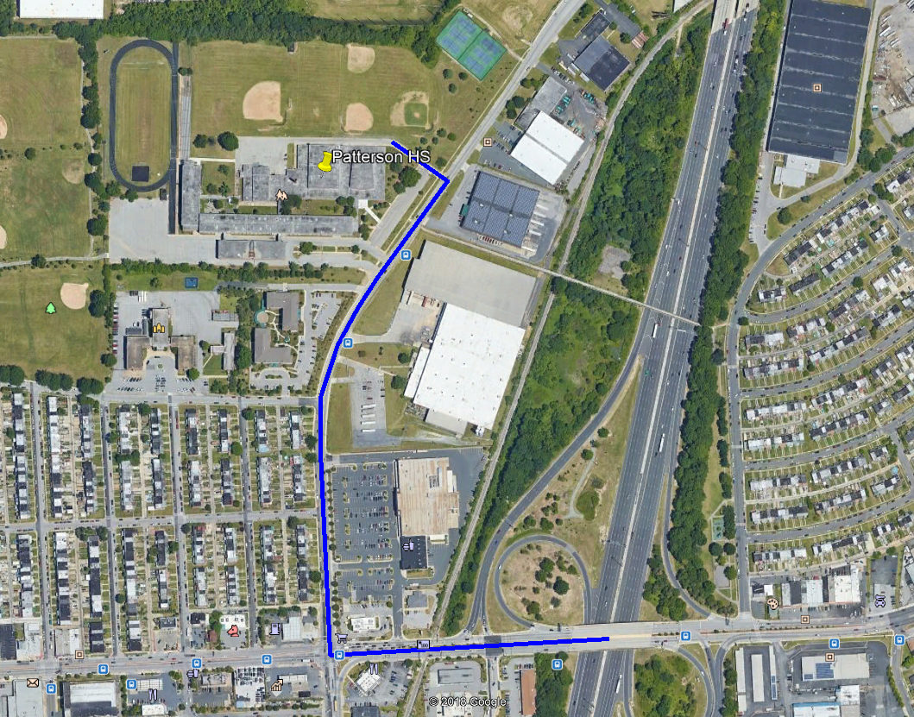
Demolition & Construction Phases
Basic overview
Hours of Operation
                6 am to 7 pm
Truck Plan
MD 95
Eastern Avenue
Kane St
No idling or overnight deliveries
Rodent Plan
Rodent mitigation for both construction and demo phases
Logistics
Waste management will be handled by onsite dumpsters
Regular street sweeping to keep roads clean
Site security will be provided by perimeter fence and cameras
Community Meeting: “Construction Update” | Patterson High School & Claremont Middle/High School | October 8, 2019 | www.baltimore21stcenturyschools.org

Slide 9
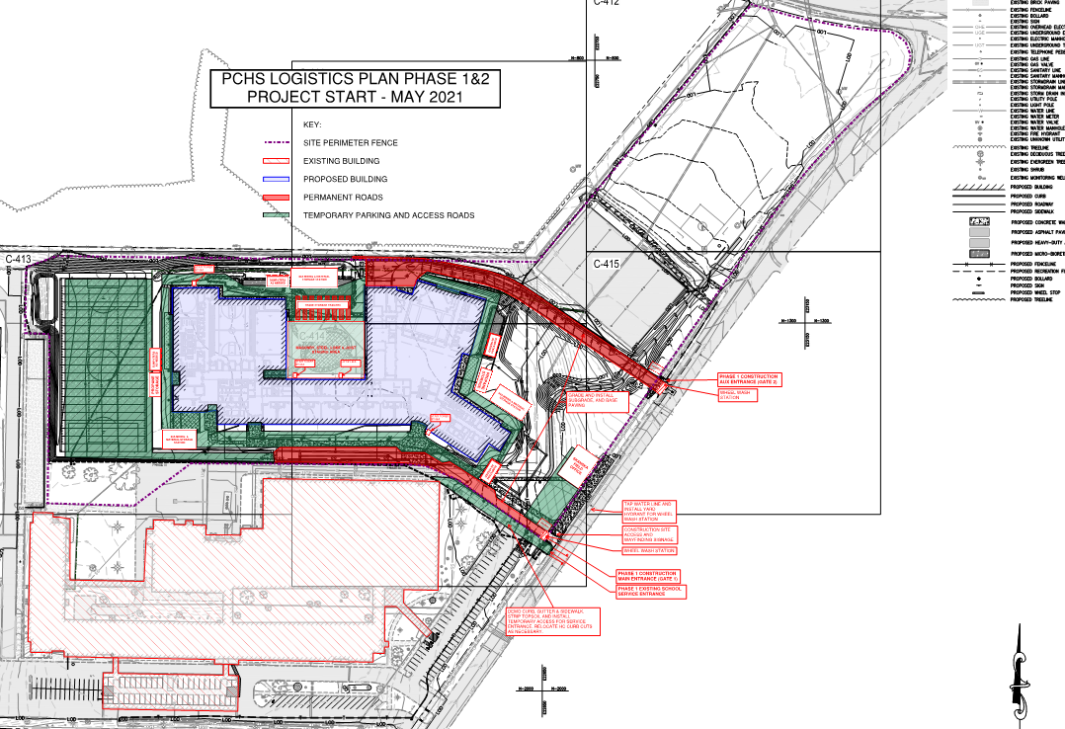
Phase 1 & 2 Logistics
Community Meeting: “Construction Update” | Patterson High School & Claremont Middle/High School | October 8, 2019 | www.baltimore21stcenturyschools.org

Slide 10
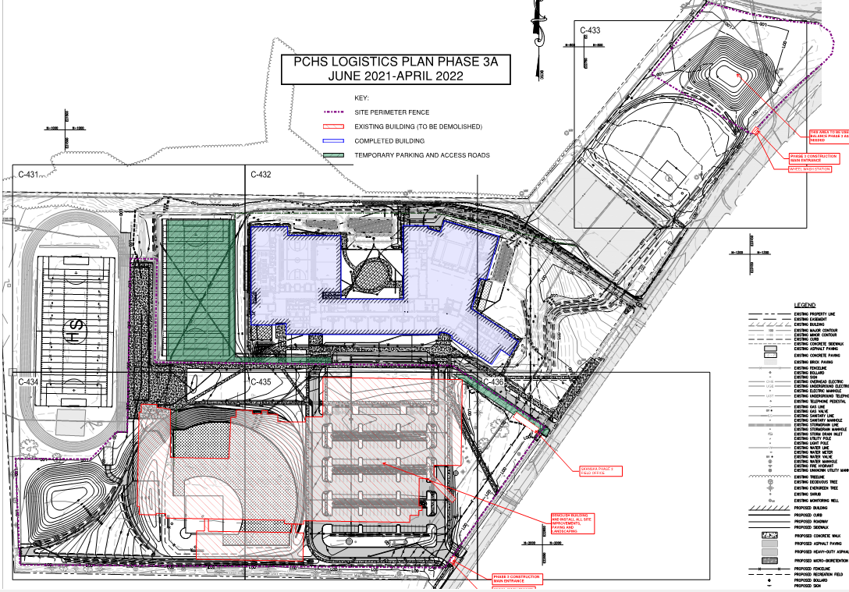
Phase 3a Logistics
Community Meeting: “Construction Update” | Patterson High School & Claremont Middle/High School | October 8, 2019 | www.baltimore21stcenturyschools.org

Slide 11
Phase 3 Logistics
Community Meeting: “Construction Update” | Patterson High School & Claremont Middle/High School | October 8, 2019 | www.baltimore21stcenturyschools.org

Slide 12
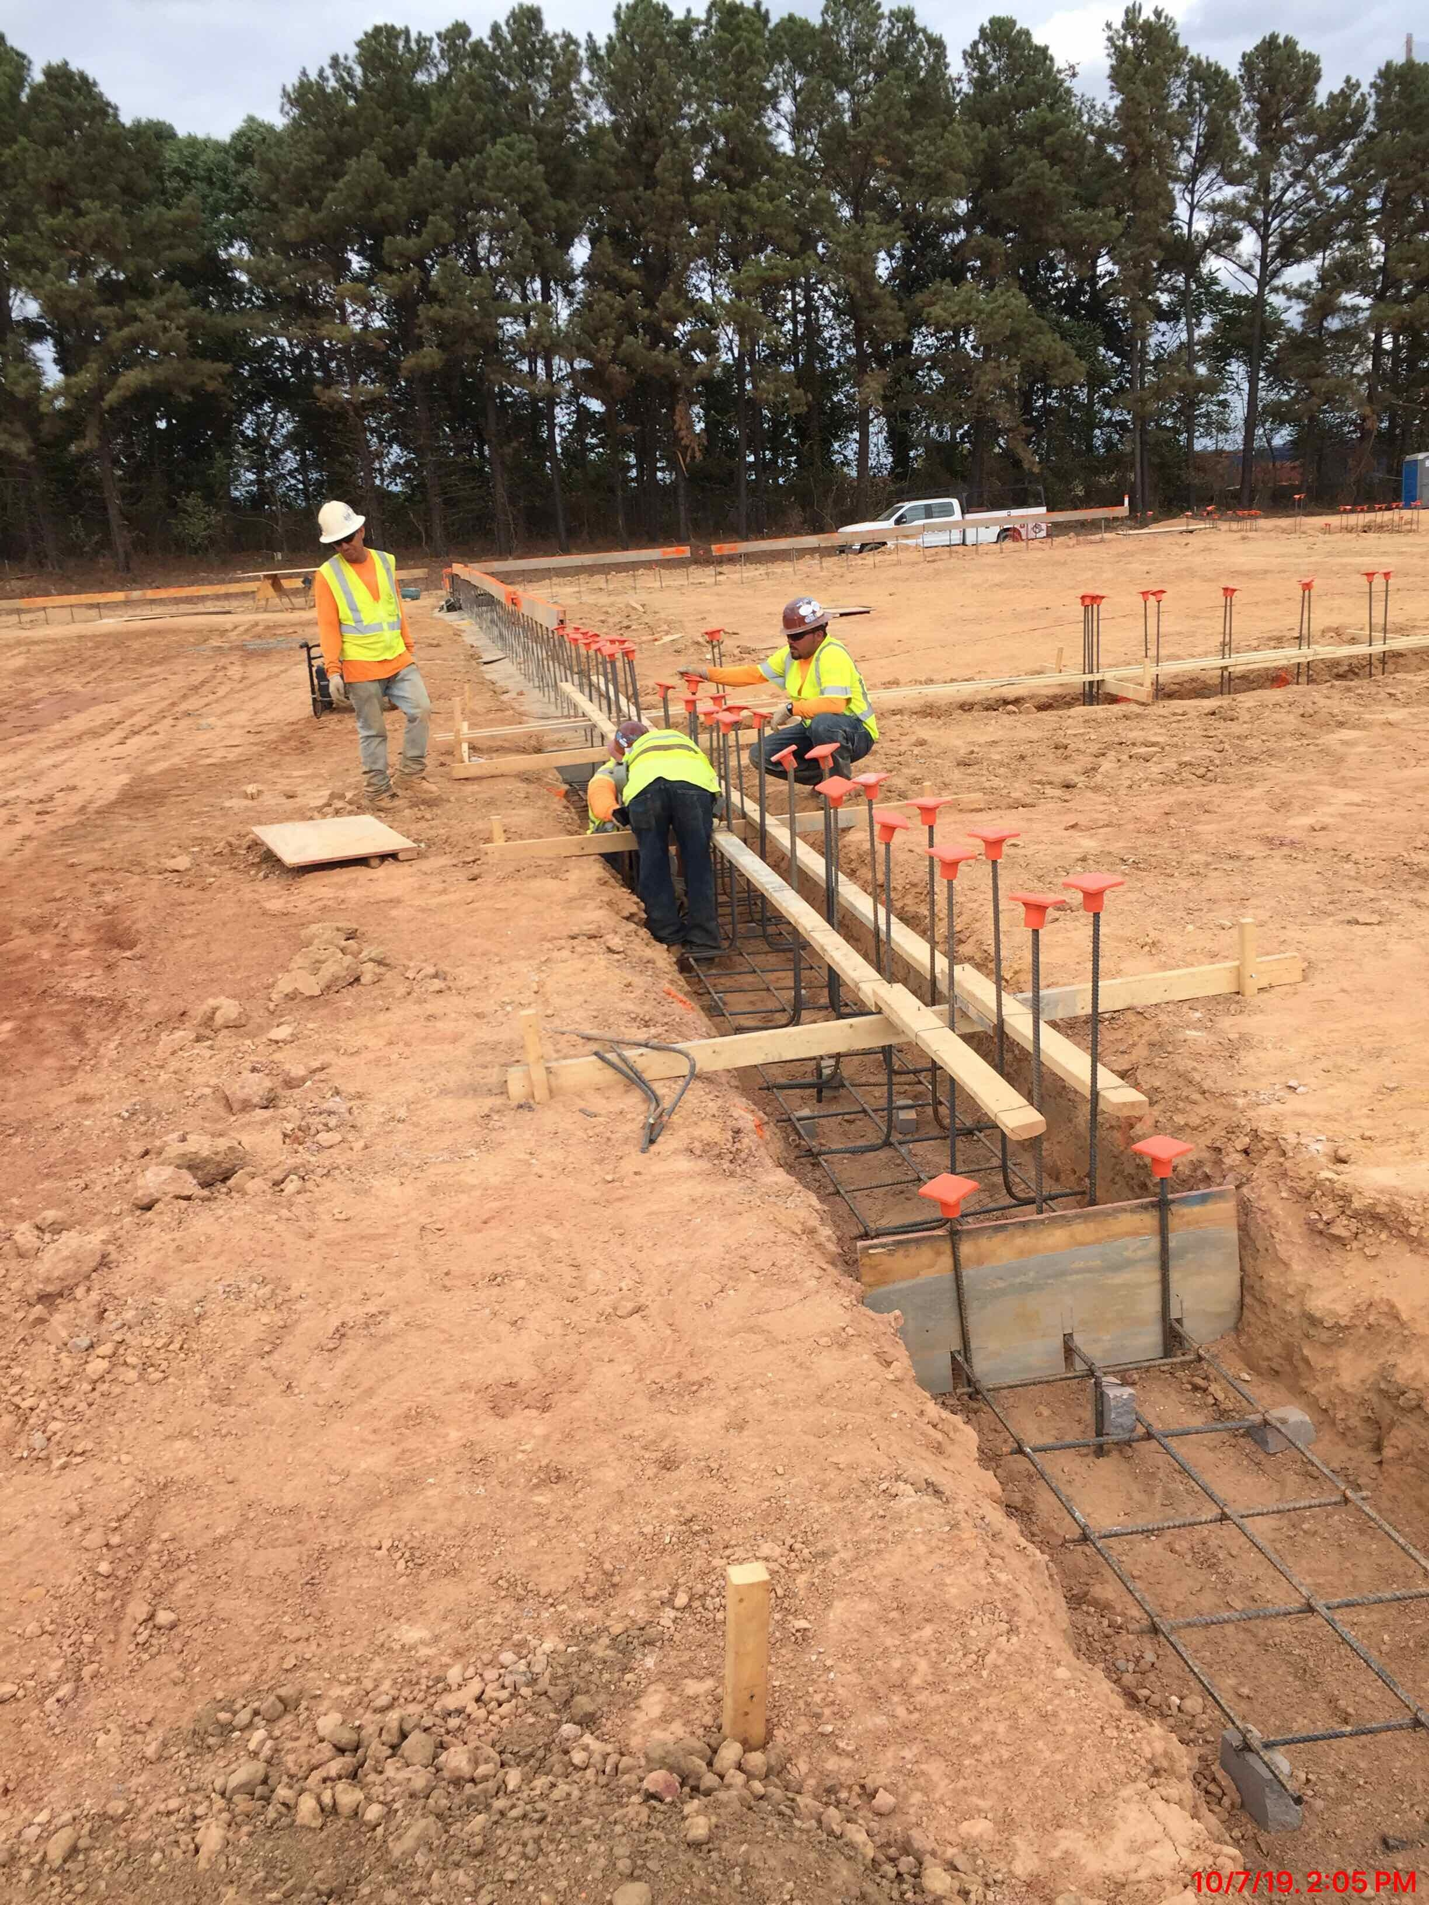
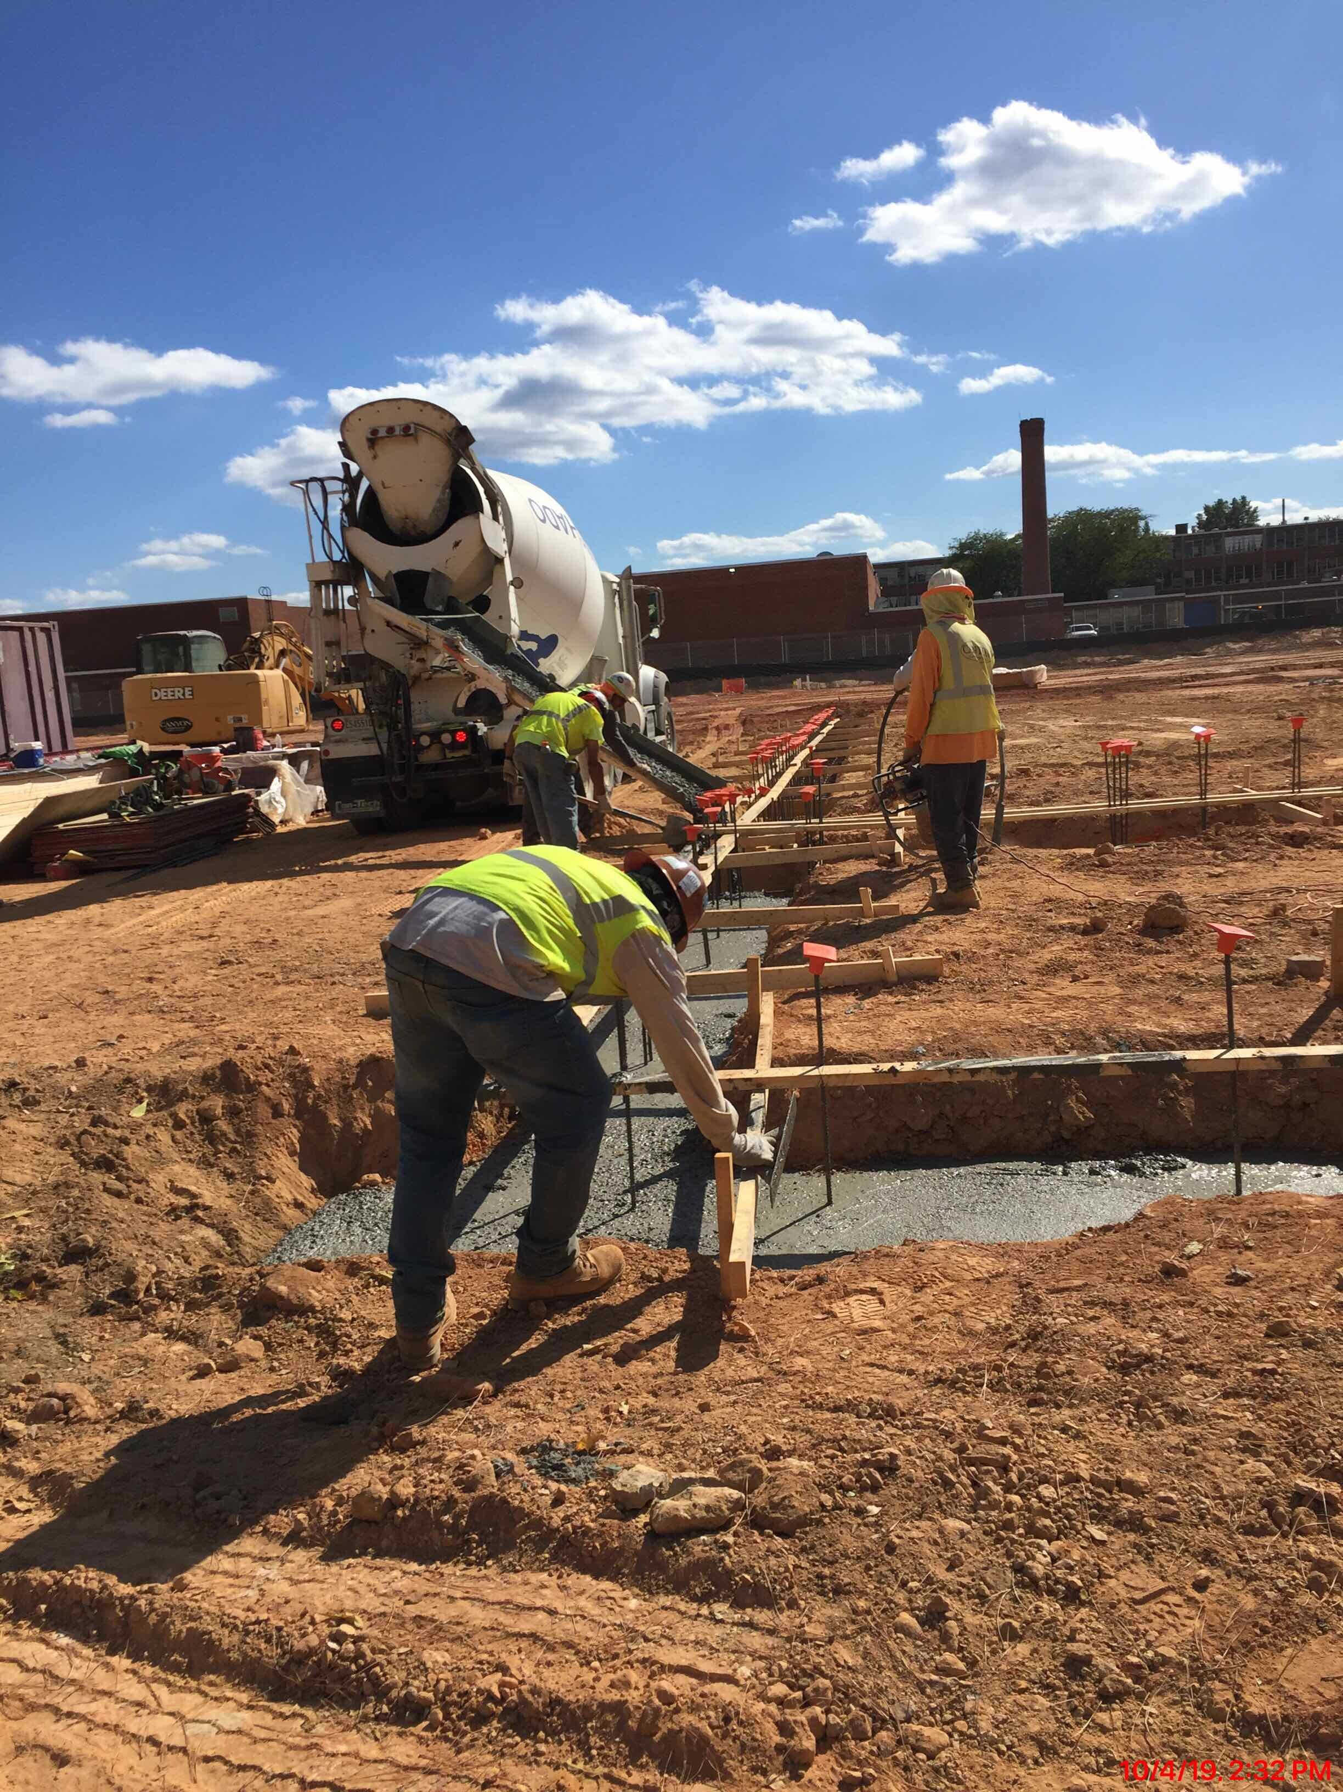
Area A Foundations
Community Meeting: “Construction Update” | Patterson High School & Claremont Middle/High School | October 8, 2019 | www.baltimore21stcenturyschools.org

Slide 13
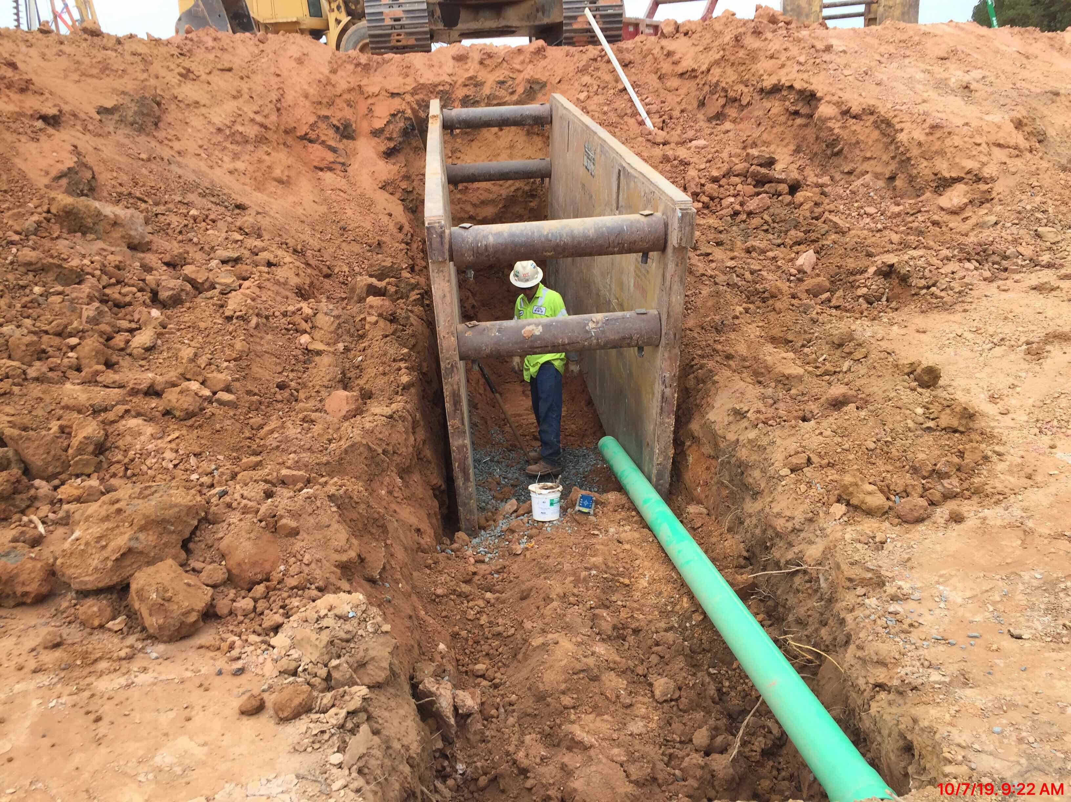
Site Work & Utilities
Community Meeting: “Construction Update” | Patterson High School & Claremont Middle/High School | October 8, 2019 | www.baltimore21stcenturyschools.org

Slide 14
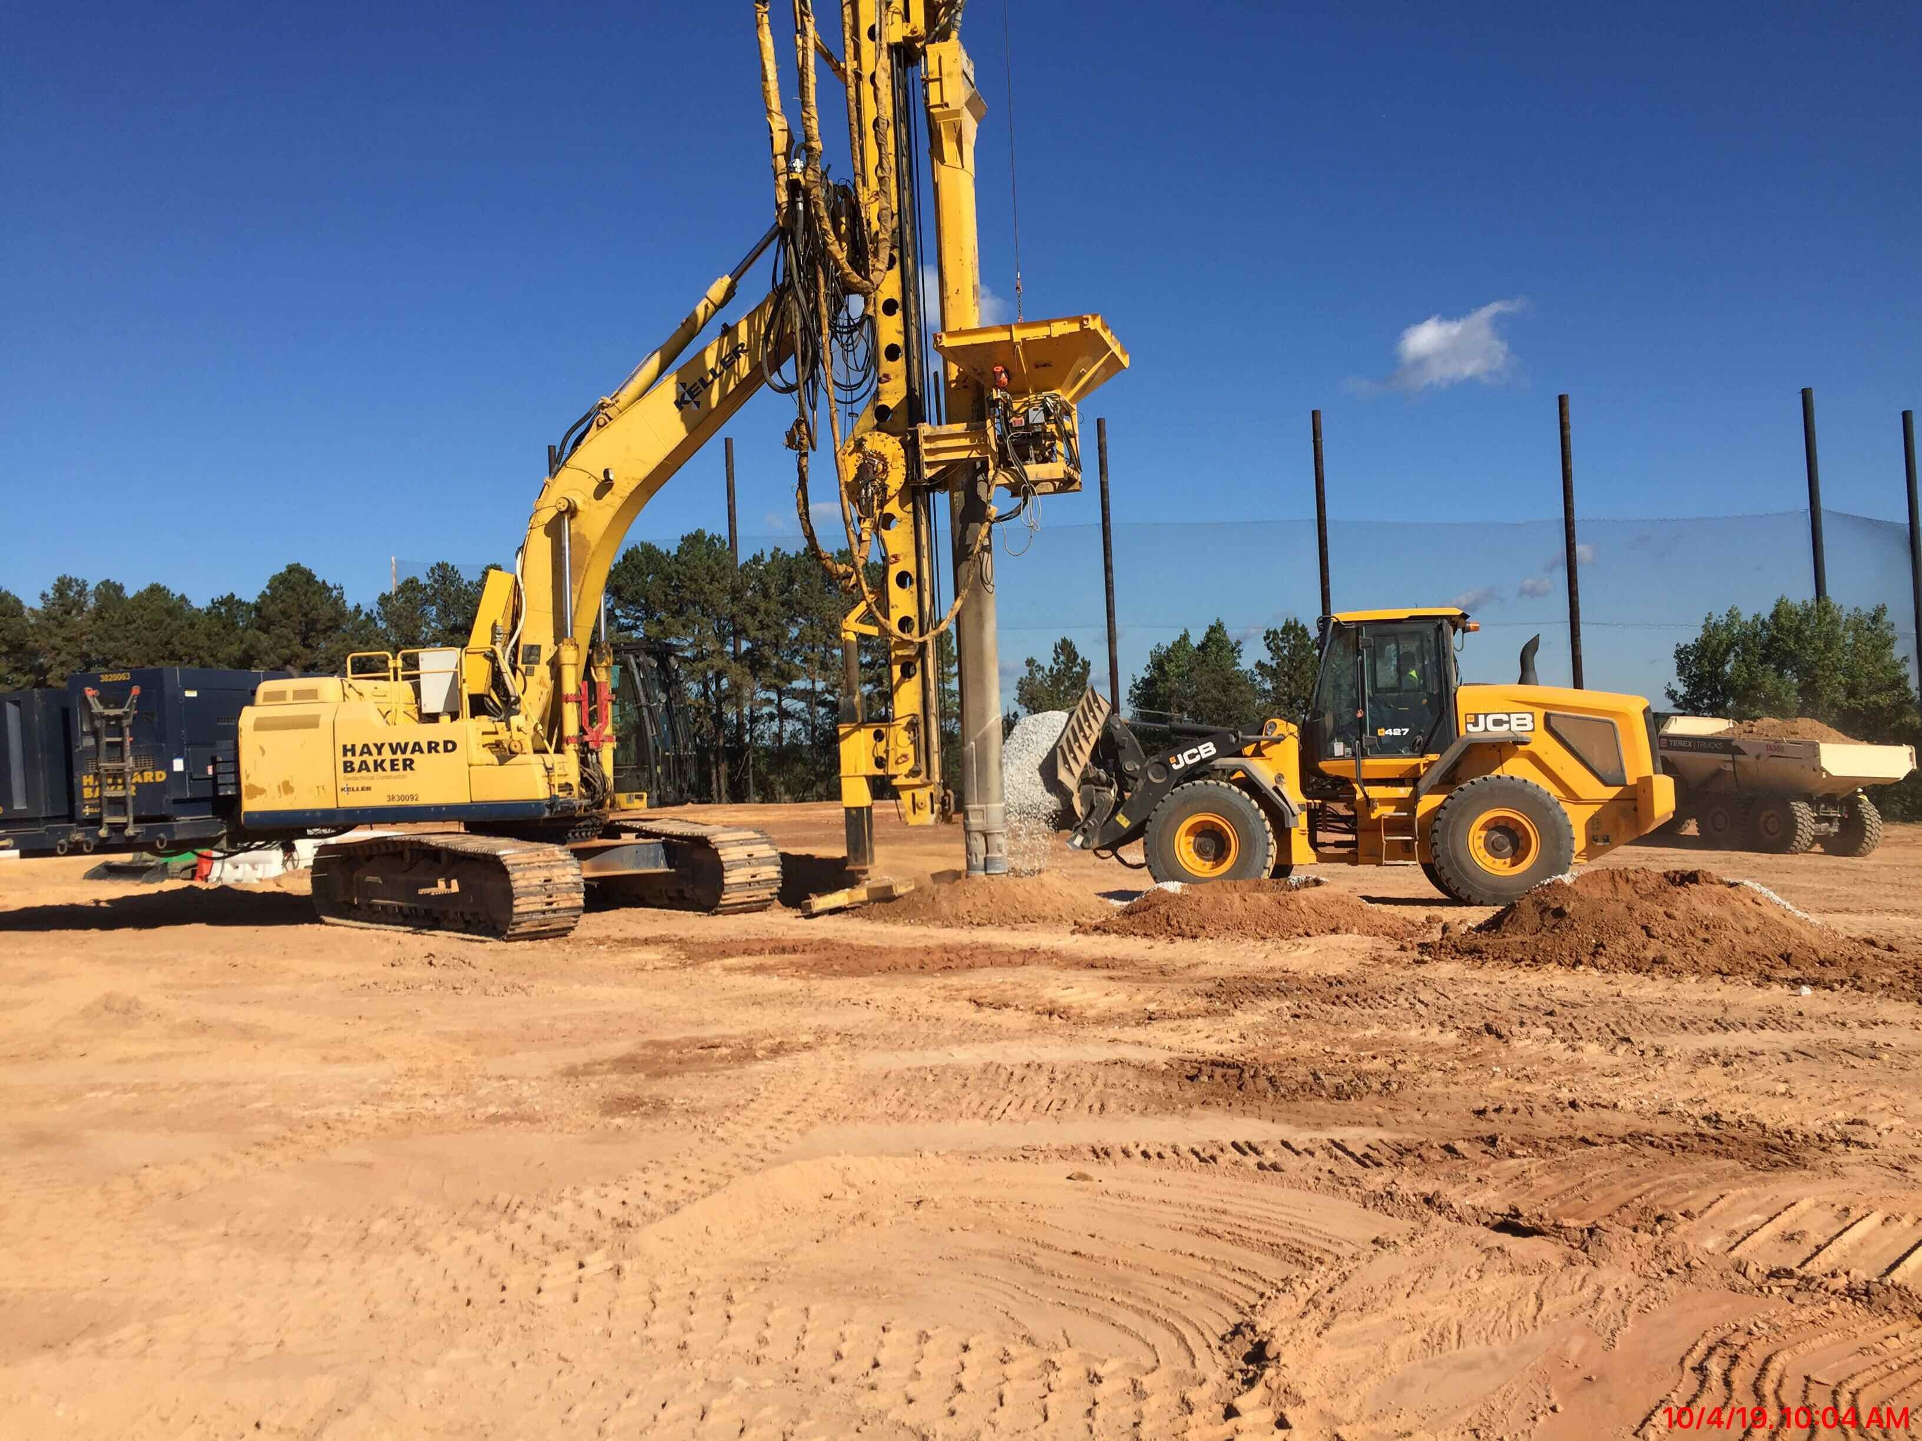
Area C, D and E Rammed Aggregate Piers
Community Meeting: “Construction Update” | Patterson High School & Claremont Middle/High School | October 8, 2019 | www.baltimore21stcenturyschools.org

Slide 15
Next Steps
Excavate and install building footings
Install MEP under-slab rough-ins
Install building footings
Install under slab vapor barrier
Install building CMU walls in Area A
Install steel framing in Area A
Install slab on grade Area A
All work proceeds Area A>B>C>D>E
Site utility installation
Retaining walls along tennis courts
Community Meeting: “Construction Update” | Patterson High School & Claremont Middle/High School | October 8, 2019 | www.baltimore21stcenturyschools.org

Slide 16

Questions?
CONTACTS
Alicia Thomas
AThomas03@bcps.k12.md.us
21st Century School Buildings
Program Office
(443) 642-4600
www.baltimore21stcenturyschools.org
Instagram
@21stCSBaltimore
Twitter
@21stCSBaltimore
Facebook
@21stCenturySchoolBuildingsProgram

Slide 17


Thank You!
www.baltimore21stcenturyschools.org
21st Century School Buildings Program
Baltimore City Public Schools
200 East North Avenue Room 407-B
Baltimore MD 21202
(443) 642-4600
Dorothy Hellman
Executive Director, 21st Century Buildings Program
Baltimore City Public Schools
Gary McGuigan
Senior Vice President, Capital Development Division
Maryland Stadium Authority
James T. Smith, Jr.
Chief of Strategic Alliances
City of Baltimore
Robert Gorrell
Executive Director, Public School Construction Program
State of Maryland
This presentation is brought to you by the
21st Century School Buildings Program.

